Slide 1
Software Testing and
Testing Strategies

Slide 2
Topics covered
Testing – what, who and why
Testing Strategies
  Unit testing
  Integration testing
  OO testing
  Smoke testing
  High Order testing

Slide 3
Software Testing
Testing is the process of exercising a
program with the specific intent of finding
errors prior to delivery to the end user.

Slide 4

What Testing Shows
errors
requirements conformance
performance
an indication
of quality

Slide 5


Who Tests the Software?
developer
independent tester
Understands the system
Must learn about the system,
but, will test "gently"
but, will attempt to break it
and, is driven by "delivery"
and, is driven by quality

Slide 6
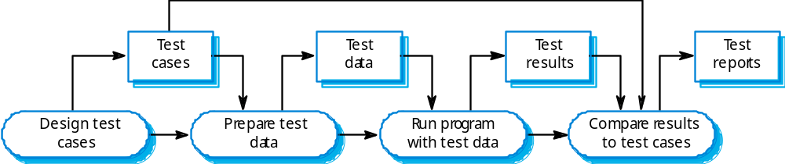
The software testing process

Slide 7

Testing Strategy
unit test
integration
test
system
test
validation
test

Slide 8
Testing Strategy
We begin by ‘testing-in-the-small’ and move toward ‘testing-in-the-large’
For conventional software
  The module (component) is our initial focus
  Integration of modules follows
For OO software
  our focus when “testing in the small” changes from an individual module (the conventional view) to an OO class that encompasses attributes and operations and implies communication and collaboration

Slide 9
Strategic Issues
State testing objectives explicitly.
Understand the users of the software and develop a profile for each user category.
Develop a testing plan that emphasizes “rapid cycle testing.”
Build “robust” software that is designed to test itself
Use effective formal technical reviews as a filter prior to testing
Conduct formal technical reviews to assess the test strategy and test cases themselves.
Develop a continuous improvement approach for the testing process.

Slide 10


Unit Testing
module
to be
tested
results
software
engineer
test cases

Slide 11
Unit Testing
module
to be
tested
interface
local data structures
boundary conditions
independent paths
error handling paths
test cases

Slide 12
Unit Test Environment
driver
interface
local data structures
Module
boundary conditions
independent paths
error handling paths
stub
stub
test cases
RESULTS

Slide 13

Integration Testing Strategies
Options:
  • the “big bang” approach
  • an incremental construction strategy

Slide 14
Top Down Integration
A
top module is tested with
stubs
B
F
G
stubs are replaced one at
a time, "depth first"
C
as new modules are integrated,
some subset of tests is re-run
D
E

Slide 15
Bottom-Up Integration
A
B
F
G
drivers are replaced one at a
time, "depth first"
C
worker modules are grouped into
builds and integrated
D
E
cluster

Slide 16
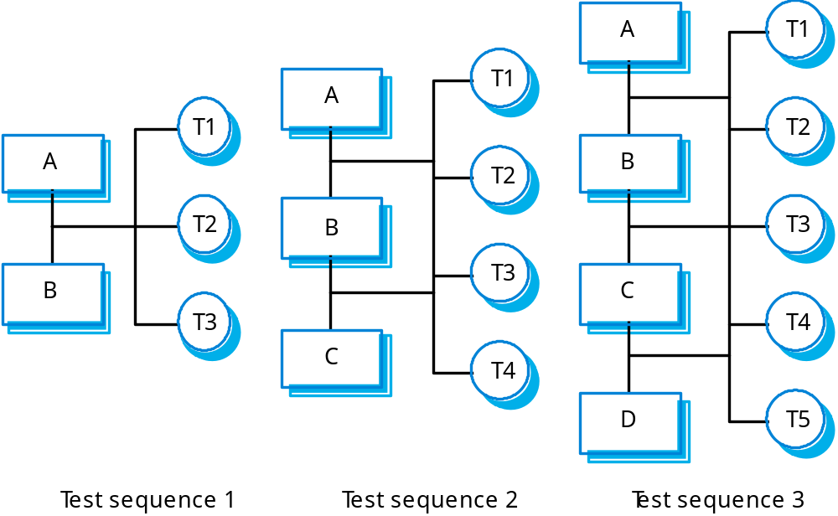
Incremental integration testing

Slide 17
Object-Oriented Testing
Begins by evaluating the correctness and consistency of the OOA/OOD models
Testing strategy changes
  the concept of the ‘unit’ broadens
  integration focuses on classes and their execution across a ‘thread’ or in the context of a usage scenario
  validation uses conventional black box methods
Test case design draws on conventional methods, but also encompasses special features

Slide 18
OOT Strategy
class testing is the equivalent of unit testing
  operations within the class are tested
  the state behavior of the class is examined
integration applied three different strategies
  thread-based testing—integrates the set of classes required to respond to one input or event
  use-based testing—integrates the set of classes required to respond to one use case
  cluster testing—integrates the set of classes required to demonstrate one collaboration

Slide 19
Smoke Testing
A common approach for creating “daily builds” for product software
Smoke testing steps:
  New software components are integrated into a “build.”
    A build includes all data files, libraries, reusable modules, and engineered components that implement one or more product functions.
  A series of tests is designed to expose errors that will keep the build from properly performing its function.
    The intent should be to uncover “show stopper” errors that will throw the software project behind schedule.
  The build is integrated with other builds and the entire product (in its current form) is smoke tested daily.
    The integration approach may be top down or bottom up.

Slide 20
High Order Testing
Validation testing
  Focus is on software requirements
System testing
  Focus is on system integration
Alpha/Beta testing
  Focus is on customer usage
Recovery testing
  forces the software to fail in a variety of ways and verifies that recovery is properly performed
Security testing
  verifies that protection mechanisms built into a system will, in fact, protect it from improper penetration
Stress testing
  executes a system in a manner that demands resources in abnormal quantity, frequency, or volume
Performance Testing
  test the run-time performance of software within the context of an integrated system

